Slide 1
Timely Grocery
Making Grocery More Convenient
By Tin Tran, Satish Kumar, Shiva Padma, Sreedeep Katragadda
CMPE 272 – Rakesh Ranjan

Slide 2
The Problem
Every year many tons of food are wasted because they are past expiration date.
Most of the food thrown away by grocery stores is perfectly fine and can be sold at a discounted price before they actually expire.
People who are on a budget have trouble finding inexpensive groceries.

Slide 3
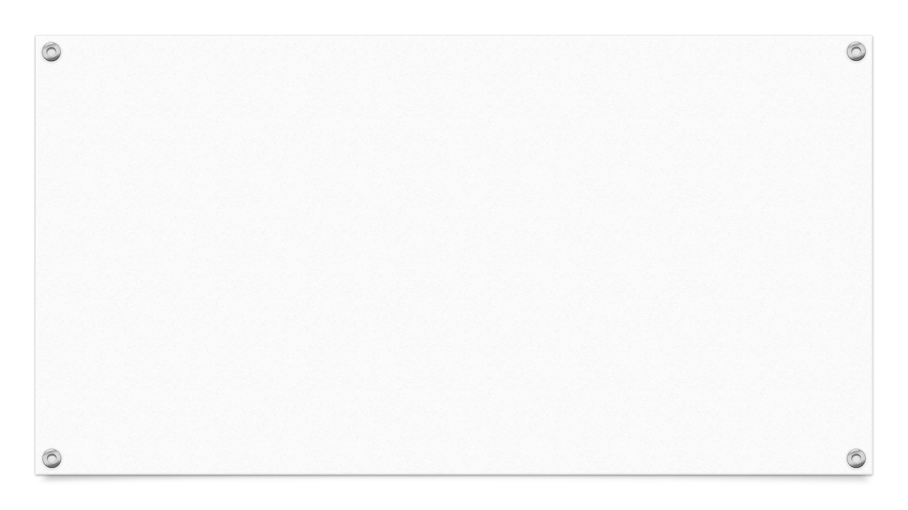
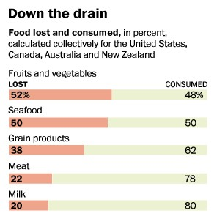
Wastage Estimate
USDA estimates that stores toss out $15 billion worth of food alone each year because the products have neared their expiration date or got expired.

Slide 4
The Solution
We create an online portal for local grocery stores to show their discounted groceries before they expire.
Customers who are looking for such items will be able to find compare prices between the stores, making finding the discounted items easier and faster.
Our unique solution let retailers opt for dynamic pricing and allow customers choose the best prices from all the local grocery stores.

Slide 5
What we used
HTML/CSS/Bootstrap
PHP
MySQL in AWS RDS
Apache Server
AWS for Cloud Hosting

Slide 6
Demo

